Slide 1
App modernization
Kulcsár Gábor
Solution architect
S&T Consulting Hungary Kft.

Slide 2

Abstract and learning objectives
In this whiteboard design session, you work with a group to analyze and design a solution for moving legacy on-premises applications and infrastructure to cloud services. As part of the modernization effort, you will discuss modern concepts such as Serverless.
At the end of this workshop, your ability to design and implement a modernization plan for organizations looking to move services from on-premises to the cloud will be improved.

Slide 3
Step 1: Review the customer case study
Outcome
Analyze your customer needs.
Timeframe
15 minutes

Slide 4

Customer situation
Parts Unlimited is an online auto parts store.
Its mission is to make buying vehicle replacement parts easy for consumers and professionals.
Notes:
Parts Unlimited is an online auto parts store. Founded in Spokane, WA, in 2008, they are providing both genuine OEM and aftermarket parts for cars, sport utility vehicles, vans, and trucks, including new and remanufactured complex parts, maintenance items, and accessories. Its mission is to make buying vehicle replacement parts easy for consumers and professionals.

Slide 5
Customer situation - 2
A Windows Server 2019 hosting the web commerce
A SQL Server 2008 R2 hosting the website.
On-premises servers maintained by a hardware technician and a system administrator.
Out of business software vendor.
Small team with only two software engineers.

Slide 6
Customer needs
Assess Migration to Azure
Migrate to Azure
Migrate to managed services
Ability to scale against unexpected load
Testing-in-production issues
DevOps Introduction
Scalable Order Processing System
Notes:
Parts Unlimited wants to assess its current environment to see if it can move its e-commerce site to the cloud as it is.
Parts Unlimited wants to move to the cloud and be able to scale its e-commerce solution.
They want to migrate their SQL Server 2008 R2 database to a fully-managed SQL database in Azure. They are not sure how to manage SQL resources during unexpected peak times.
Parts Unlimited wants to find a solution for their testing in production problem. They want to be able to test functionality before pushing it to their servers.
They want to minimize human errors in deployments. They heard about DevOps practices and that publishing from developer machines is not ideal.
Parts Unlimited is looking to separate its order processing subsystem and scale it independently to accommodate a large number of orders.

Slide 7

Customer objections
Our developers were not able to migrate our .NET Core 2.2 application to a more recent version. Should we expect a steep upgrade path with every new version?
When a .NET Core version is EoL (End-of-Life), does that mean we cannot host our solution in Azure?
We hear a lot about Kubernetes. What is the difference between App Services and Kubernetes?
We have plans to scale to Mexico and Brazil. Anything we should be worried about while moving to Azure?

Slide 8
Customer questions
High-level architecture
Diagram your initial vision for handling the top-level requirements for the e-commerce site, database, DevOps, and order processing.
Assessment and Migration
Where should Parts Unlimited start its assessment and migration journey? Is there a single place to start and find all the tools and services?
What tools would you recommend Parts Unlimited use to assess and migrate its web application? How would you use these?
What tools would you recommend Parts Unlimited use to migrate its database? How would you use these? Be specific.
What Azure service would host the website?
Would there be any problems with the .NET Core version being EoL (End-of-Life)?
Modernization
What Azure service would provide a scalable, serverless solution for order processing that handles unexpected spikes and can be implemented with the least amount of code change required in the web application?
Parts Unlimited wants to create PDF invoices. What would be a serverless way of implementing it?
How can Parts Unlimited monitor its application performance in the cloud?
How can Parts Unlimited make sure their SQL Database in the cloud always has the right amount of resources to accommodate unexpected spikes in load?
DevOps
Parts Unlimited wants to test new functionality and bugfixes before shipping to production. What would you suggest?
Parts Unlimited team is familiar with GitHub. How would you suggest them to set up a CI/CD pipeline?

Slide 9
Step 3: Present the solution
Outcome
Present a solution to the target customer in a 15-minute chalk-talk format.
Timeframe
30 minutes (15 minutes for each team to present and receive feedback)
Directions
Pair with another team.
One group is the Microsoft team and the other is the customer.
The Microsoft team presents their proposed solution to the customer.
The customer asks one of the objections from the list of objections in the case study.
The Microsoft team responds to the objection.
The customer team gives feedback to the Microsoft team.
Switch roles and repeat Steps 2-6.

Slide 10
Wrap-up
Outcome
Identify the preferred solution for the case study.
Identify solutions designed by other teams.
Timeframe
15 minutes

Slide 11

Preferred target audience
Casey Jensen, CEO, Parts Unlimited, Ltd.
The primary audience is business and technology decision-makers.
Usually, we talk to the Infrastructure Managers who report to the CIOs, or application sponsors (like a VP LOB, CMO), or to those that represent the Business Unit IT or developers that report into application sponsors.

Slide 12
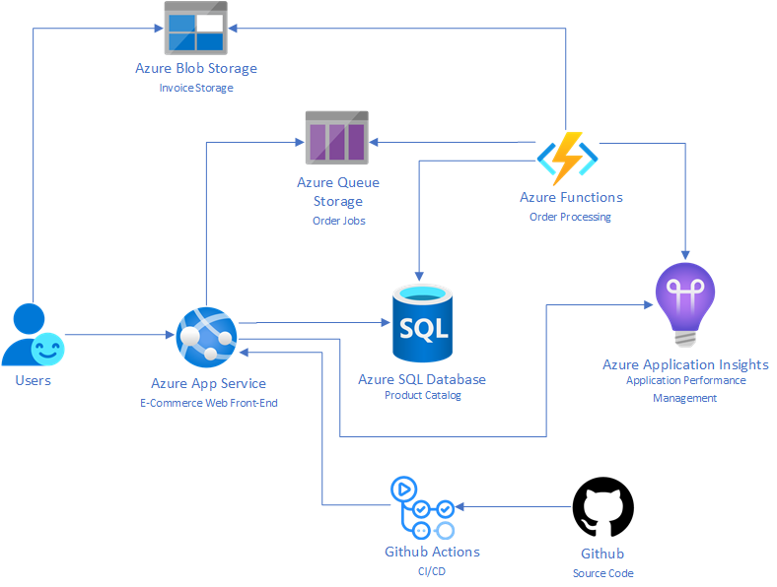
Step 2: Design the solution
Notes:
The solution begins with assessing Parts Unlimited's E-Commerce application with App Service Migration Assistant. Once the assessment succeeds, Parts Unlimited can move to migrate their e-commerce site to an App Service with the App Service Migration Assistant's help. In the case of Parts Unlimited, despite their fears of using an EoL (End-of-Life) .NET Core version, the assessment does not show any blockers. After having App Service Migration Assistant provision an App Service and migrating their application Parts, Unlimited is happy having the front-end moved to the cloud.
migrate Parts Unlimited's SQL Server 2008 R2 database to Azure SQL Database using the Azure Database Migration Service (DMS) The next step is to . Using the Data Migration Assistant (DMA) assessment, Parts Unlimited determines that they can migrate into a fully-managed SQL Database service in Azure. The assessment revealed no compatibility issues or unsupported features that would prevent them from using Azure SQL Database.
For async order processing, Parts Unlimited will modify its e-commerce site to submit order jobs into an Azure Storage Queue. The code change will be minimal. An Azure Function will be implemented to take the jobs from the queue and process orders, create PDF invoices for each order, and finally upload invoices into an Azure Storage Blob to be served to customers through the e-commerce site directly from blobs using SAS links.
For DevOps, Parts Unlimited will use a git repository on GitHub to host its codebase. A CI/CD pipeline will be hosted on top of GitHub Actions building and deploying the solution to a staging deployment slot in the Azure App Service. Parts Unlimited can swap slots once they are happy with the changes deployed to staging.

Slide 13
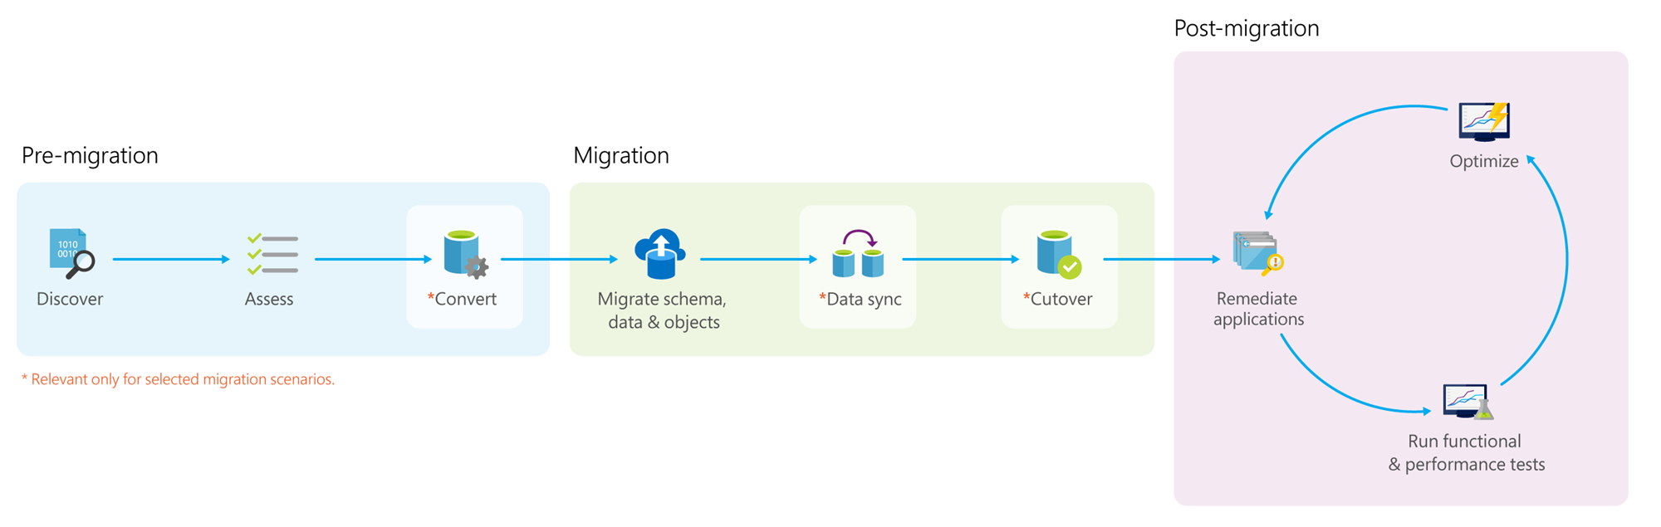
Migration process
Notes:
Pre-migration:
Discover: Inventory your source database assets and perform an application stack discovery.
Assess: Assess source workloads and fix recommendations.
Convert: Convert the source schema to work in the target environment. This is only relevant for heterogeneous migrations.
Migration:
Migrate schema, data, and objects: Migrate the source schema and then migrate the source data to the target.
Sync data: Sync your target schema and data with the source. This is only relevant for minimal-downtime migrations.
Cutover: Cutover from the source to the target environment. This is only relevant for minimal-downtime migrations.
Post-migration:
Remediate applications: Iteratively make any necessary changes to your applications.
Perform Tests: Iteratively run functional and performance tests.
Optimize: Based on the tests you performed, address any performance issues, and then retest to confirm the performance improvements.

Slide 14
Assessment and Migration
Azure Migrate provides a centralized hub to assess and migrate on-premises servers, infrastructure, applications, and data to Azure.
The App Service Migration Assistant
Azure Database Migration Service's (DMS)
Database Migration Assistant (DMA)
Database Experimentation Assistant (DEA)
Migration to a higher version of .NET
The .NET Portability Analyzer
Notes:
Azure App Service is the best solution for running ASP.NET web apps on Azure. The App Service Migration Assistant can be used to assess whether their apps have dependencies on unsupported features on Azure App Service. App Service Migration Assistant can run readiness checks and get potential remediation steps for common issues. The assistant provides step-by-step guidance for moving a web app to App Service. Parts Unlimited can use Azure Migrate to consolidate all assessment and migration projects.
The database migration should be handled using the Azure Database Migration Service's (DMS) that is part of Azure Migrate. DMS is a fully managed service designed to enable seamless migrations from multiple database sources to Azure Data platforms with minimal downtime. It provides customers with a comprehensive, highly available migration solution. The service uses the Data Migration Assistant to generate assessment reports that provide recommendations to guide you through the changes required before performing a migration. When you're ready to begin the migration process, the Azure Database Migration Service executes all of the steps necessary, following best practices as determined by Microsoft.
The Data Migration Assistant (DMA) enables you to upgrade to a modern data platform by detecting compatibility and feature parity issues that can impact an upgrade or migration to your target version of SQL Server or Azure SQL Database. DMA also provides recommendations on performance and reliability improvements you can make once your databases have been migrated to your target environment. It allows you to move your schema, data, and uncontained objects (SQL Agent jobs, SSIS packages, roles, users, and logins) from your source server to your target server.
The Database Experimentation Assistant (DEA) is an A/B testing solution for SQL Server upgrades. It assists in evaluating specific workloads against a targeted version of SQL Server or SQL Database. DEA is not a migration tool but can be used to help determine the appropriate target version of SQL Server or SQL Database for migrations.
The App Service Migration Assistant indicates no issues for Parts Unlimited to move to Azure. However, it is strongly suggested to move to a supported version post-migration. The .NET Portability Analyzer can be used to assess how much work is required for a migration.

Slide 15
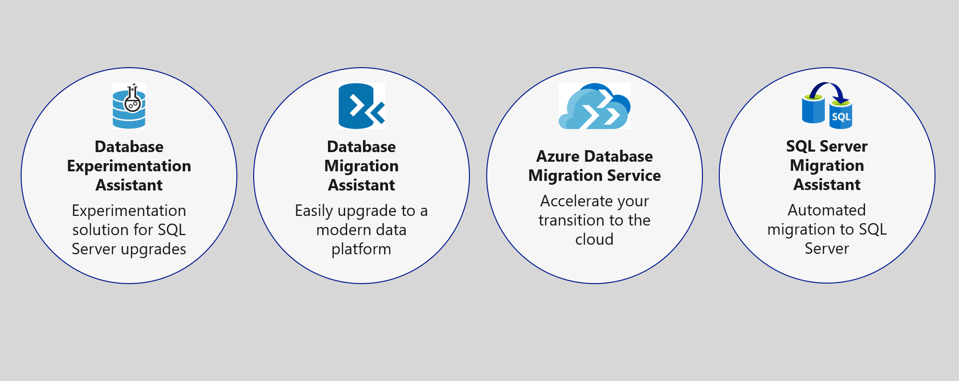
Preferred solution – Data Management
Migrate database to Azure SQL using Database Migration Service

Slide 16
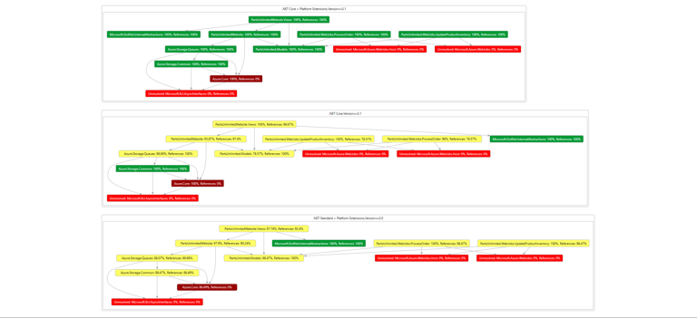
The .NET Portability Analyzer
Notes:
The .NET Portability Analyzer is a tool that analyzes assemblies and provides a detailed report on .NET APIs that are missing for the applications or libraries to be portable on your specified targeted .NET platforms. The Portability Analyzer is offered as a Visual Studio Extension, which analyzes one assembly per project, and as an ApiPort console app, which analyzes assemblies by specified files or directory. Here you see a DGML file showing dependencies in the Parts Unlimited web application.

Slide 17
Modernization
Azure Functions consumption plan for Serverless Order Processing
Application Insights for Performance Management
Serverless helps with unexpected spikes in load for SQL Server
Notes:
Azure Functions can be used to develop a solution that can ingest order jobs from an Azure Storage Queue and process orders at scale. The only code change required on the web application would relate to adding jobs into the queue. Azure Functions consumption plan provides instances of the Functions host that are dynamically added and removed based on incoming events. The consumption plan is aligned with Parts Unlimited's requirements. Parts Unlimited pays only when the functions are running, and the platform scales automatically, even during periods of high load. For PDF generation Function will be using headless Chromium that only works on Linux. Parts Unlimited can deploy their function to Linux Consumption Plans to make their solution work.
Application Insights, a feature of Azure Monitor, is an extensible Application Performance Management (APM) service for developers and DevOps professionals. Parts Unlimited can use it to monitor their e-commerce application live. Application Insights will automatically detect performance anomalies and include powerful analytics tools to help developers diagnose issues and understand what users actually do with their app. It's designed to help developers continuously improve performance and usability.
Serverless is a compute tier for single databases in Azure SQL Database that automatically scales compute based on workload demand and bills for the amount of compute used per second. The serverless compute tier also automatically pauses databases during inactive periods when only storage is billed and automatically resumes databases when activity returns. The serverless compute tier for single databases in Azure SQL Database is parameterized by a compute autoscaling range and an auto-pause delay. The configuration of these parameters shapes the database performance experience and compute cost.

Slide 18
DevOps
Azure App Service Deployment Slots
GitHub Actions
Azure App Service Deployment Center
Notes:
When you deploy your web app to Azure App Service, you can use a separate deployment slot instead of the default production slot. Deployment slots are live apps with their hostnames. App content and configuration elements can be swapped between two deployment slots, including the production slot. Deploying your application to a non-production slot helps you validate app changes in a staging deployment slot before swapping it with the production slot. After a swap, the slot with the previously staged app now has the previous production app. If the changes swapped into the production slot aren't as you expect, you can immediately perform the same swap to get your "last known good site" back.
GitHub Actions is an excellent place to automate, customize, and execute your software development workflows right in your repository with. Developers can build, test, and deploy their code right from GitHub. App Service comes with a Deployment Center functionality that streamlines GitHub integration. Parts Unlimited can use the Deployment Center to create a CI/CD pipeline targeting a staging App Service Deployment Slot.

Slide 19
Preferred objection handling
Our developers were not able to migrate our .NET Core 2.2 application to a more recent version. Should we expect a steep upgrade path with every new version?
When a .NET Core version is EoL (End-of-Life), does that mean we cannot host our solution in Azure?
We hear a lot about Kubernetes. What is the difference between App Services and Kubernetes?
We have plans to scale to Mexico and Brazil. Anything we should be worried about while moving to Azure?
Notes:
- We have [The .NET Portability Analyzer](https://docs.microsoft.com/en-us/dotnet/standard/analyzers/portability-analyzer) that can be used to assess how much work is required for a migration. We know projects that can migrate with a single configuration change and others who had to do some work based on the application's complexity and code dependencies. The .NET Portability Analyzer can give you a good idea of how much effort is required to migrate to a newer version, including an assessment of all your code dependencies.
- When a .NET Core version is EoL (End-of-Life), does that mean we cannot host our solution in Azure?
After the End-Of-Lime time, .NET Core patch updates will no longer be available for .NET Core 2.2. Your application will still run. .NET Core 2.2 was released as a non-LTS (Long Term Support) release. A non-LTS ("Current") release is supported for three months after the next release. For hosting applications that you do not intend to update often, we suggest LTS releases. LTS releases include features and components that have been stabilized, requiring few updates over a longer support release lifetime. The supported upgrade path from .NET Core 2.2 is via .NET Core 3.1. .NET Core 3.1 is released December 3, 2019, as a long-term support release.
- Azure is an open cloud that offers multiple choices. We suggest App Service if you have a single or a few back-end services in an N-Tier architecture. Azure Kubernetes Services is a better fit for Cloud-Native (Microservices) design.
- Azure has 60+ regions, more than any other cloud provider. Our physical infrastructure comprises 160+ physical datacenters arranged into regions and linked by one of the world's largest interconnected networks. We have services such as Azure Traffic Manager for DNS-based traffic load balancing, Azure Front Door, a global, scalable entry-point that uses the Microsoft global edge network to create fast, secure, and widely scalable web applications, and Azure CosmosDB, a globally-distributed planet-scale database service. All these services are ready for implementation and used by millions of customers every day. We would be more than happy to help Parts Unlimited scale its operations globally.

Slide 20
Customer quote
“Microsoft has done a brilliant job with the technology they have put into the cloud. We are confident that our Azure-hosted applications are now scalable and resilient, and our team has all the tools they need to be more productive in modernizing our e-commerce platform. We could not be happier running Parts Unlimited on Azure.”
Casey Jensen, CEO, Parts Unlimited, Ltd.

